Slide 1
Static and Fluctuating Load Analysis of a Cantilever Beam

Slide 2
Introduction
This project is a code in C++ that performs static and fluctuating load analysis of a cantilever beam using Von-Mises and modified Goodman criteria. The purpose of this project is to provide a tool to analyze the structural integrity of cantilever beams under different loading conditions. By using this code, we can quickly and accurately determine whether a particular beam design is suitable for its intended application.

Slide 3
USER INPUTS
The material selection for the cantilever beam is critical to ensure that it can withstand the applied loads. Common materials used for cantilever beams include steel, aluminum. Factors such as strength, stiffness must be considered when selecting the material.
Our code allows to select materials based on the number displayed against them.
What analysis we want (Fluctuating and Static).
Material Cross Section circular or rectangle.
Material dimensions .
Load Inputs (Axial load, Tip load, Torsion).

Slide 4
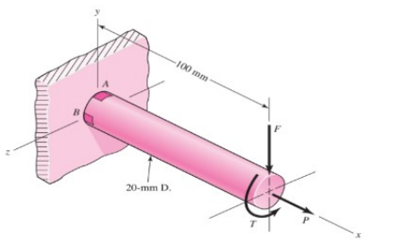

Load configuration
The load configuration for the beam must also be carefully considered.
The type and magnitude of the loads along the beam, can significantly impact the beam's performance. It is important to ensure that the beam is designed to withstand both static and fluctuating loads.

Slide 5
Static Load Analysis, Critical Elements and Von-Mises Criterion
Static Load Analysis
Static load analysis is a process used to determine the stress and strain in a structure under a static load. In this case, we are analyzing a cantilever beam under a static load. The analysis helps us understand the maximum load the beam can withstand without failure.
We are considering top and bottom most element as critical elements.

Slide 6
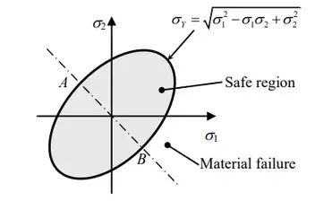
Von-Mises Criterion
The Von-Mises criterion is a mathematical formula used to determine the maximum stress that a material can withstand before failure.
It takes into account both the tensile and compressive stresses in a material, as well as the shear stresses.
In the case of a cantilever beam, we can use the Von-Mises criterion to determine the maximum load the beam can withstand without failure.

Slide 7
Fluctuating Loading
Fluctuating loading is a type of load that varies in magnitude and direction over time. In the context of the cantilever beam, this can be caused by factors such as wind, vibrations, or changes in weight distribution.
Von-Mises Stress
The Von-Mises is used to assess the stress levels in the beam caused by fluctuating loads. It takes into account both the normal and shear stresses in the beam, and provides a measure of the combined stress level. This is important because high levels of combined stress can lead to failure even if the individual stresses are within safe limits.
Modified Goodman Criterion
The Modified Goodman criterion is another method for assessing the stress levels in the beam caused by fluctuating loads. It takes into account the mean stress level as well as the alternating stress level, and provides a measure of the fatigue life of the beam. This is important because repeated cycles of fluctuating loading can lead to fatigue failure over time.

Slide 8
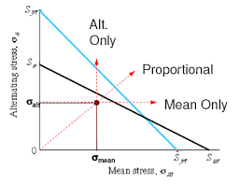
Modified Goodman Criteria and Life Cycles
Modified Goodman Criteria
The Modified Goodman criteria is a method used to predict the failure of materials subjected to cyclic loading. It is based on the principle that a material may fail due to a combination of mean stress and alternating stress. The Goodman line is a graphical representation of the relationship between mean stress and alternating stress, and it is used to determine the maximum allowable alternating stress for a given mean stress.

Slide 9
Life Cycles
The life cycle of a cantilever beam refers to the number of load cycles that the beam can withstand before failure. The life cycle is determined by the stress level in the beam, and it can be estimated using the Goodman criteria. By calculating the maximum allowable alternating stress for a given mean stress using the Goodman line, we can determine the number of load cycles that the beam can withstand before failure. This information is crucial for designing structures that are safe and reliable under cyclic loading conditions.

Slide 10
Conclusion
In conclusion, the code presented in this project provides a comprehensive analysis of a cantilever beam under static and fluctuating loads using the Von-Mises and Modified Goodman criteria. The results obtained from the analysis can be used to determine the safety and reliability of the beam in real-world applications.

